Slide 1
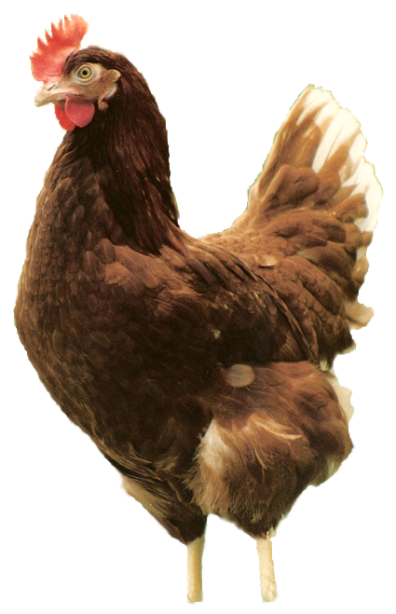

NEW RESEARCH TRENDS IN TETRA LAYER BREEDING PROGRAM
Anita Almási
Assistant Geneticist
EUWEP 2014. June 5-6.
Győr

Slide 2
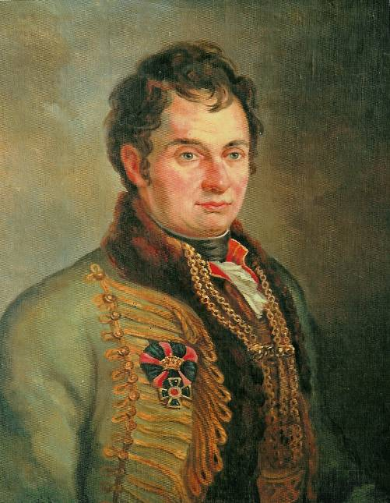
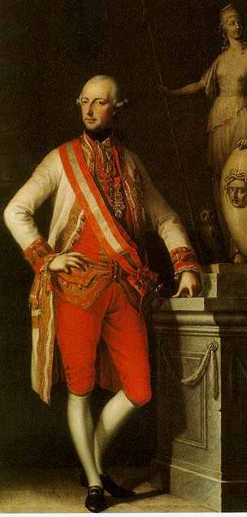
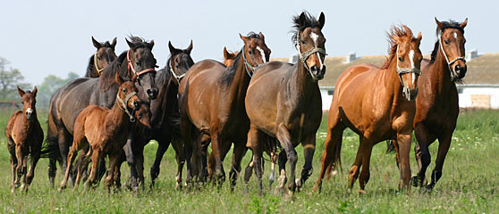
ANIMAL BREEDING
STARTED 225 YEARS AGO
József Csekonics 1757 –1824
II. József 1741-1790

Slide 3
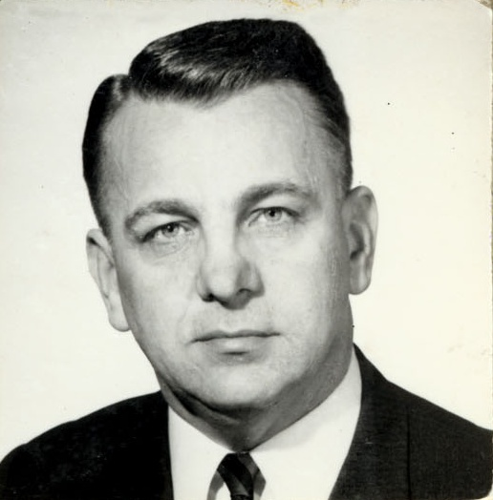
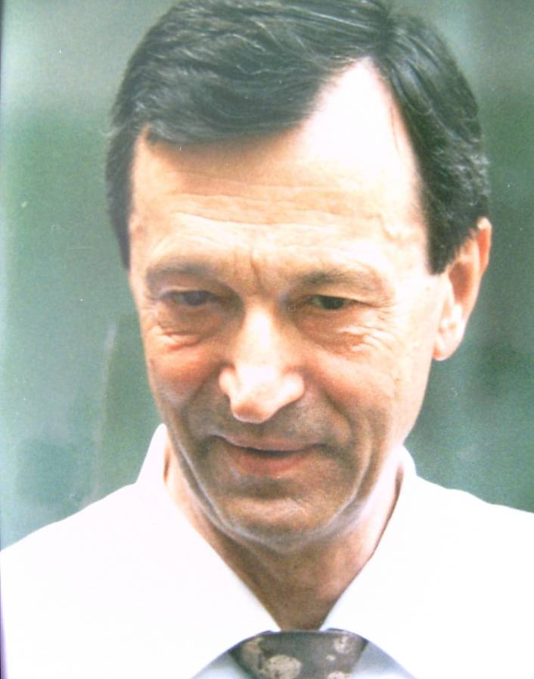
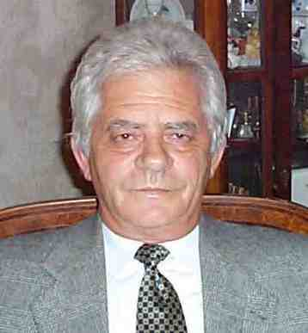
TETRA POULTRY BREEDING since 1969
Industrial poultry breeding starts in Bábolna
Official registration of the „Tetra” brand and beginning of the layer breeding program
Starting worldwide distribution of the TETRA products
Dr Burgert Róbert
Dr Gerhard Lorenz
Dr Forgács Barnabás

Slide 4
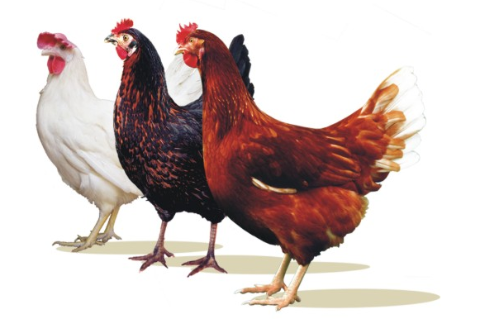
NEW FRAMEWORK
2004 - new management
Genetic program on new basis (new database - 14 generation stored)
Bigger emphasis and input on research and development
Renewing the distribution system
Sales activity increasing successively (39 countries)

Slide 5
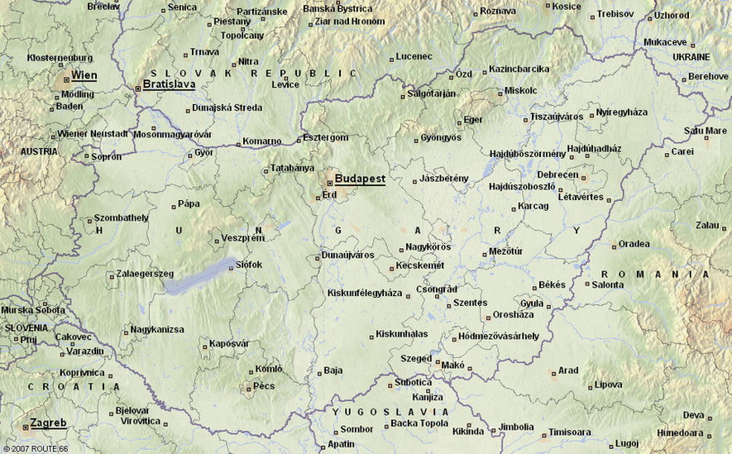
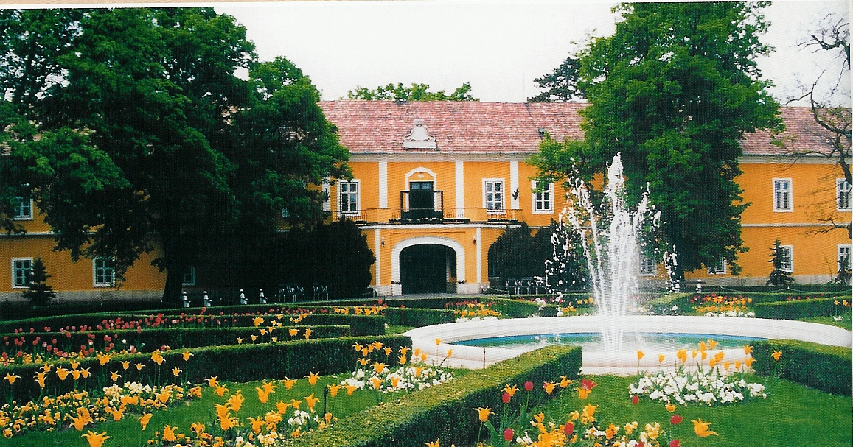


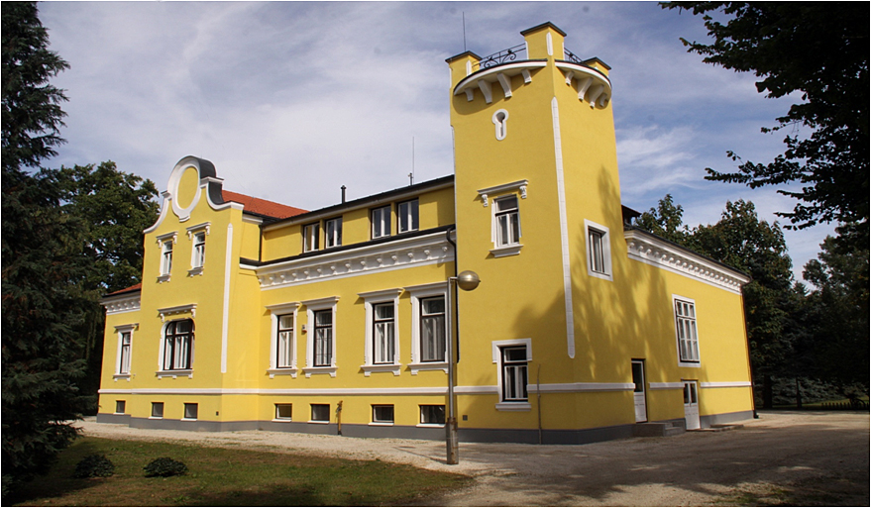
BÁBOLNA TETRA LAYER BREEDING - Offices
Bábolna
Uraiújfalu

Slide 6
BREEDING FOR QUALITY HENS

Slide 7
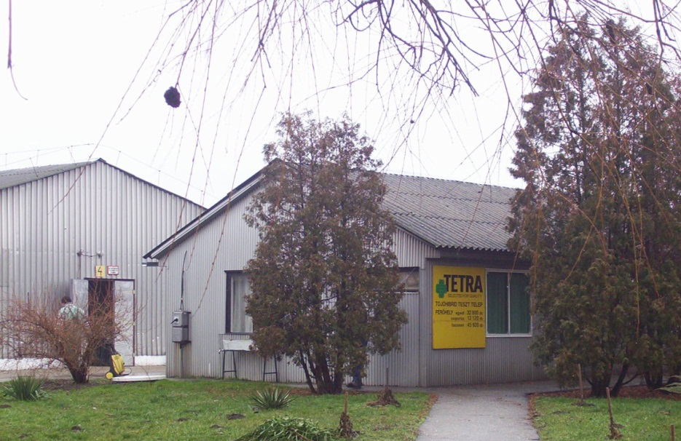
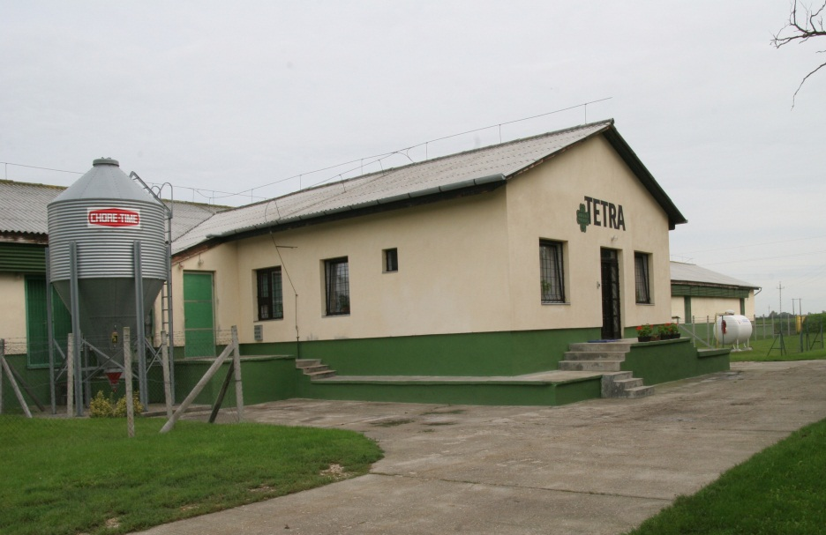
R & D PREMISES
CENTRAL PROGENY TEST FARM
Elite Lines: 7.104 Hens + 1.200 Cocks
in Individual Cages
KENDERES PEDIGREE FARM
Crossed Progenies: 9.840 Hens
in Individual Cages

Slide 8
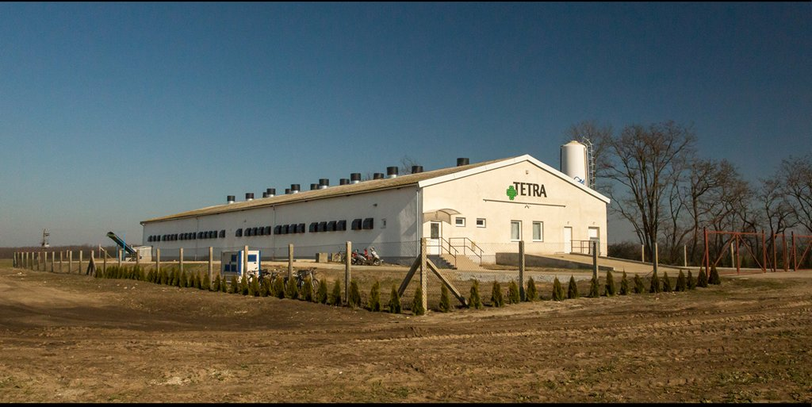
GERHARD LORENZ BREEDING UNIT
Commenced in January 2013 - (PED13)
21.280 Hens and 2.128 Cocks

Slide 9
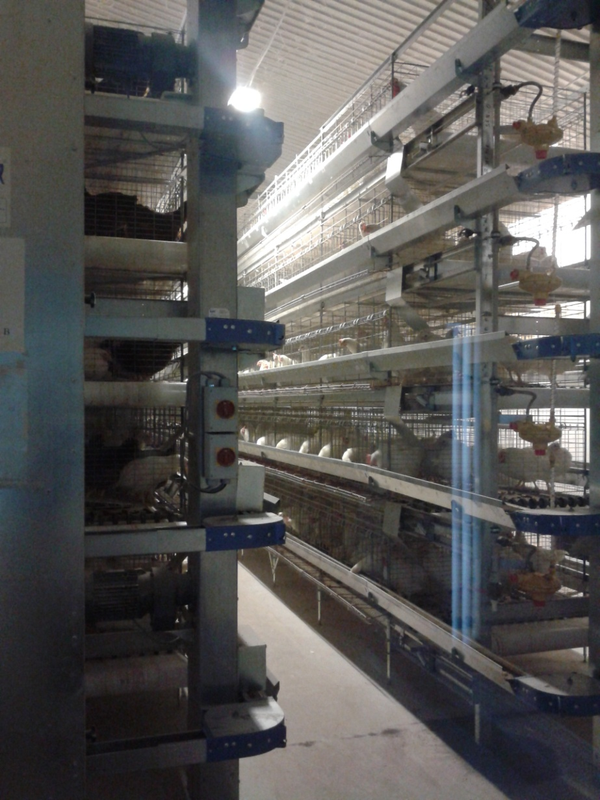
LAYOUT
Males – 5th floor
Crossed daughters – 4th floor
Elite hens – 1-3rd floor
1080 m²
7 machines, 5 floors

Slide 10
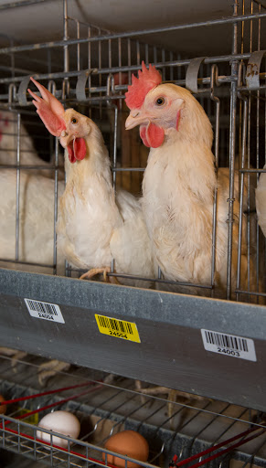
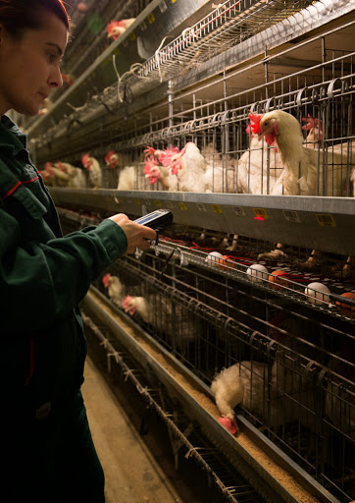

Slide 11
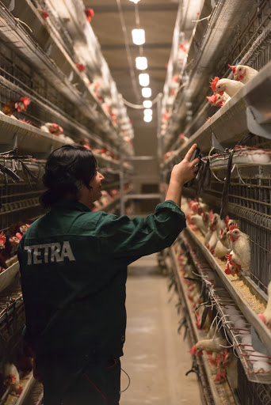
DATA COLLECTION – the basis of our genetic work
New handheld data collectors, able to record several work procedure (egg production, body weight, identification)
70. 000 individual data/day collected and stored in our personalized database
Powerful programs for predicting BV of each bird

Slide 12
BREEDING METHOD
mRRS
Control
of Pure Lines
by
Qualitative &
Quantitative
Parameters
A
B
Control
of Pure Lines
by
Qualitative &
Quantitative
Parameters
Pure Lines
♂ ♀
PED12
♂ ♀
AB
Crossed Progeny Test
BA
♀ ♀
KUT11
♀ ♀
A’
B’
Improved
Pure
Lines
♂ ♀
♂ ♀
PED13

Slide 13
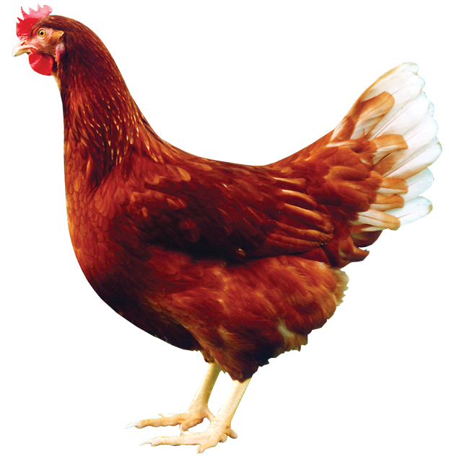
MAIN TRAITS MEASURED
Egg production ( 4 periods)
Persistency
Early maturity
Feed intake (g/d)
Feed conversion
Body weight
Livability
Egg shell color
Egg shell strength
Egg weight
Albumen height (Haugh Unit)
Blood and meat spots
Speckled and purple eggs
INDEX
Free from TMA
Free from Leucosis
Resistency
Fertility
Hatchability
Feathering
Social behavior
Free range behavior
Nest acceptance, floor eggs

Slide 14
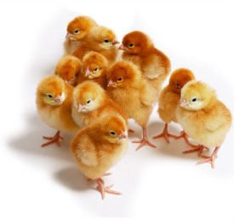
SELECTION
Individual performance data, collected in field tests
Elite, full and half sibs, parents, daughters
Individual and group performance
Molecular and population genetics
Extended progeny tests in different environments (cage, aviary systems) are already ongoing
Notes:
Selection is based primarily on IP. We have scientific collaboration with diff. institutes

Slide 15
WHERE ARE WE GOING?

Slide 16
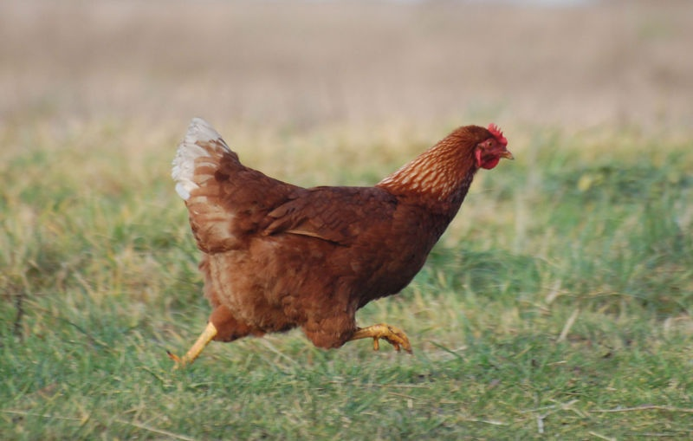
AIMS FOR THE COMING YEARS
Long Life Program
Multi-environmental tests (systems, climate, sub-optimal feeding)
Further improvement of egg quality (last period)
Sustainability (body weight, FCR)
Molecular genetic tools

Slide 17
LONG LIFE LAYING PROGRAM SINCE 2008
1970: 74 LW 260 Eggs
1990: 76 LW 300 Eggs
2005: 80 LW 350 Eggs
2012: 90 LW 410 Eggs
400 +

Slide 18
RESULTS OF OUR PROGENY TESTS – CPT11
(TETRA-SL )
Individual cage system
Production intensity %
Previous progeny test (2010-2011-2012)
100 weeks
Around 450 eggs HH
Liveweeks

Slide 19
RESULTS OF OUR PROGENY TESTS – CPT12
(TETRA-SL )
Individual cage system
Production intensity %
Current progeny test (2012-2013-2014)
 | Technology |  |  | Production
 | hen | % |  | hen |  | %
Mortality% 17-19 LW | 22 | 0,45 |  | 15 |  | 0,30
Mortality% 20-96 LW | 402 | 8,2 |  | 456 |  | 9,31
Total number of eggs | 2 136 238 |  | 96 |  | 2 196 952
Egg/hen | 435,9 |  | liveweeks |  | 448,3

Slide 21
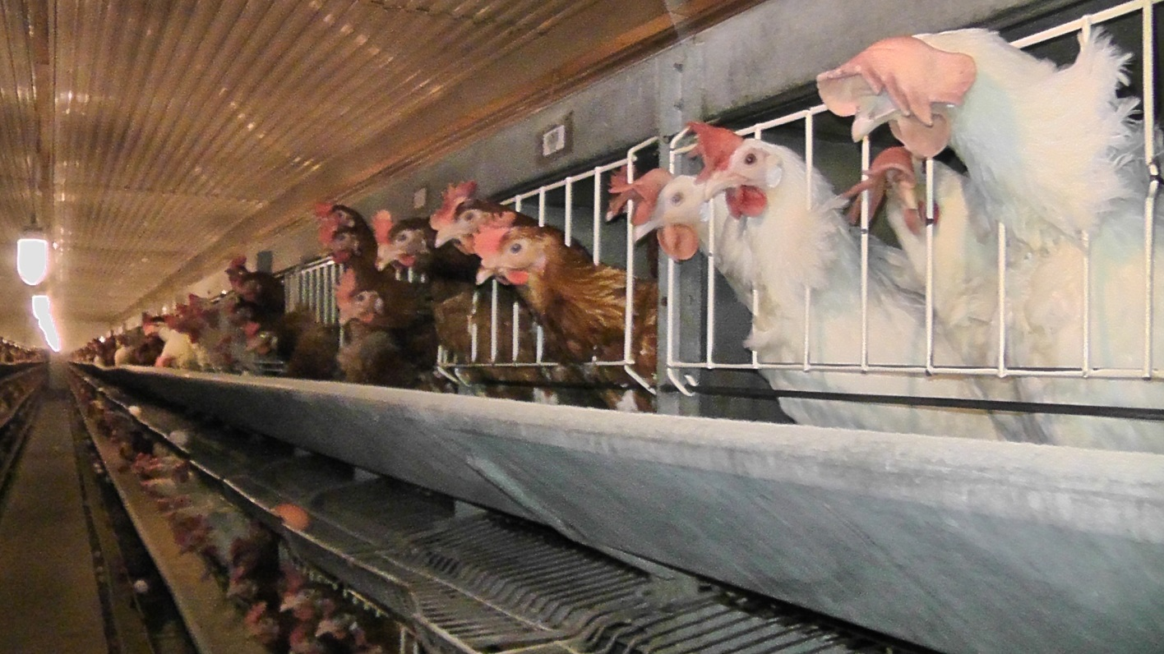
OUR LATEST PROGENY TEST– CPT14
(TETRA-SL, AMBER, BLANCA )
Grouped cage system
89 different combinations
35 LW , 90-98% production intensity

Slide 22
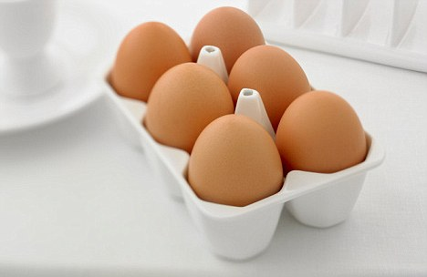
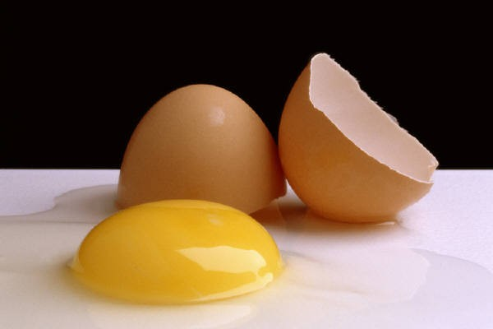
EGG QUALITY
Success in exceeding laying period, further extension of persistency is limited
Internal and external egg quality should be maintained until the end of the laying!
Complete refurbishment of our instruments, modern data collection and analysis
Individual measurements (35, 65 and 80 weeks of age)

Slide 23
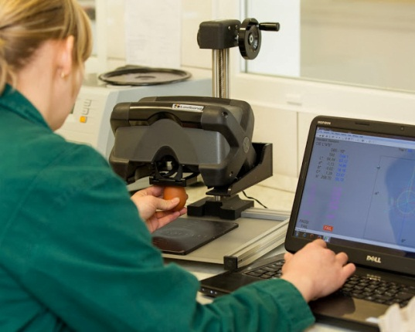
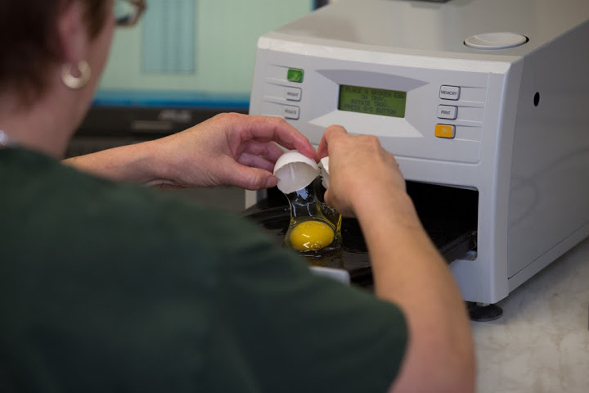
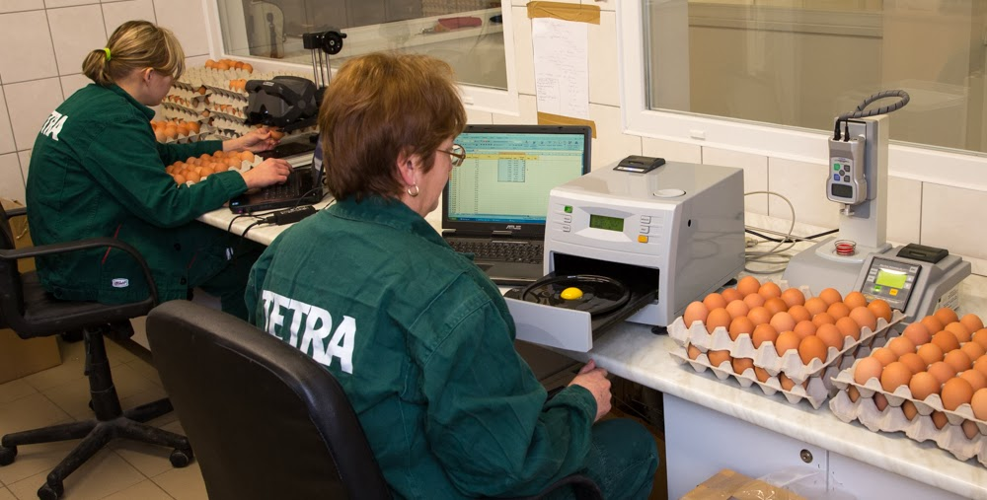
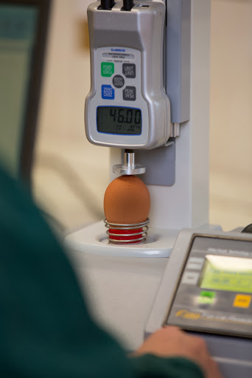

Slide 24
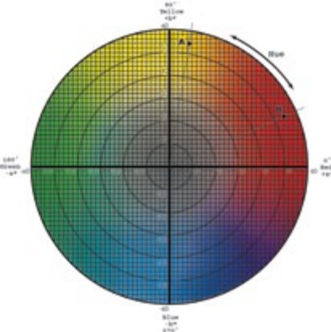
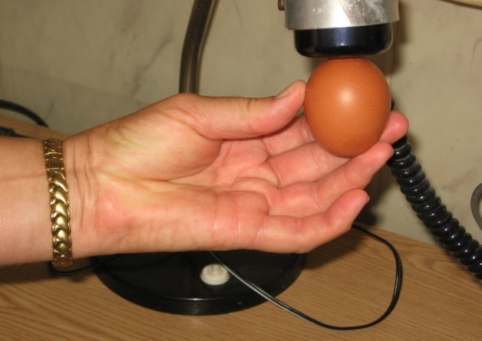
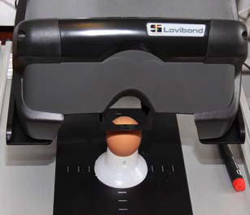
EGG QUALITY – SHELL COLOUR
Egg shell color
h² =0.50-0.60
Reflectometer (lightness-darkness)
Genetic correlation between values measured by reflectometer
L* | a* | b*
0,987363 | -0,8637 | 0,094883
Spectrophotometer
(L*, a*, b*)

Slide 25
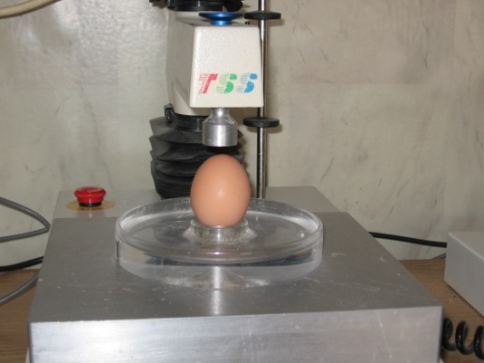
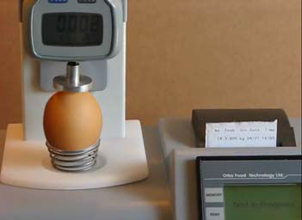
EGG QUALITY – SHELL STRENGHT
Shell strength
h² =0.2-0.25
Shell strength changes over time
Measurements are made at the blunt end

Slide 26
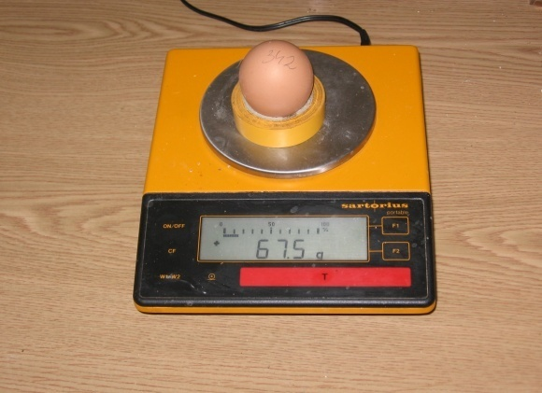
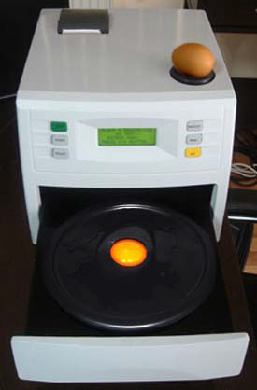
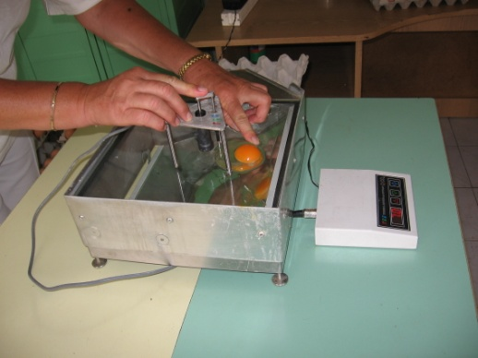
EGG QUALITY – WEIGHT and ALBUMEN HEIGHT
Egg weight
h² =0.50-0.60
Albumen height
h² = 0.20-0.30

Slide 27
EFFECT OF 18 WEEKS BODY WEIGHT ON MATURITY AND EGG PRODUCTION
Body Weight (kg) |  |  | n | Maturity(d) | Start % | TOP % | Eggs
1,00 | - | 1,09 | 1 | 172 | 26 | 95 | 31
1,10 | - | 1,19 | 11 | 166 | 34 | 82 | 31
1,20 | - | 1,29 | 92 | 162 | 46 | 96 | 40
1,30 | - | 1,39 | 415 | 161 | 51 | 97 | 42
1,40 | - | 1,49 | 1 076 | 159 | 54 | 96 | 43
1,50 | - | 1,59 | 1 423 | 157 | 58 | 96 | 45
1,60 | - | 1,69 | 1 087 | 154 | 64 | 96 | 47
1,70 | - | 1,79 | 566 | 151 | 71 | 95 | 50
1,80 | - | 1,89 | 189 | 147 | 77 | 95 | 52
1,90 | - | 1,99 | 56 | 143 | 84 | 93 | 55
2,00 | - | 2,09 | 5 | 140 | 96 | 94 | 60
2,20 | - | 2,29 | 1 | 134 | 98 | 90 | 60
Normal distribution

Slide 28
EFFECT OF 35 WEEKS BODY WEIGHT ON PRODUCTION INTENSITY AND PERSISTENCY
Body Weight (kgs) |  |  | Hens | Eggs | START % | MAIN% | LAST %
35 LW |  |  | N | 90 LW | 18-21 LW | 22-80 LW | 80-90 LW
 | - | 1,80 | 519 | 390 | 56 | 83 | 60
1,81 | - | 1,90 | 715 | 408 | 56 | 87 | 64
1,91 | - | 2,00 | 1 049 | 409 | 57 | 87 | 62
2,01 | - | 2,10 | 1 332 | 412 | 57 | 88 | 64
2,11 | - | 2,20 | 1 355 | 411 | 56 | 88 | 64
2,21 | - | 2,30 | 918 | 406 | 55 | 87 | 62
2,31 | - | 2,40 | 496 | 411 | 56 | 88 | 64
2,41 | - | 2,50 | 284 | 404 | 55 | 86 | 62
2,51 | - |  | 179 | 385 | 55 | 82 | 58
Normal distribution

Slide 29

MOLECULAR GENETIC TOOLS FOR THE IMPROVEMENT OF PERFORMANCE TRAITS
We are able to look behind the performances, traits to the DNA level
Direct identification of the characteristics might be based on the genetic markers – MAS (Marker Assisted Selection)
Mainly interested hidden or hard to test performance traits, characteristics
Dr Hidas András
tudományos főmunkatárs – Senior Researcher

Slide 30
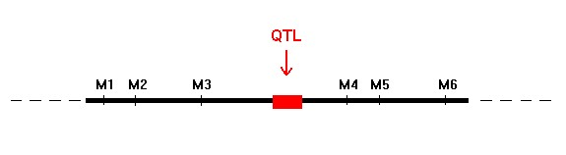
MARKER ASSISTED SELECTION (MAS)
Based on the genetic maps, more and more major genetic factors of different traits are mapped to certain regions of the genome
(QTL – quantitative trait loci).

Slide 31
CHALLANGES IN MARKER ASSISTED SELECTION (MAS)
Identified QTL-s and markers for beneficial gene variants valid for the population and the generation where mapped
Marker and QTL linkage is not tight enough - recombination may easily occur
Different genetic background might have influence with gene interactions
Genotype – environment interactions
Idea of the optimal genotype
Genetic progress looks never ending during the conventional selection decades
NO sign of worn out of production traits
Selection used as a tool for accumulating the ideal genes + evaluation of the new mutations

Slide 32
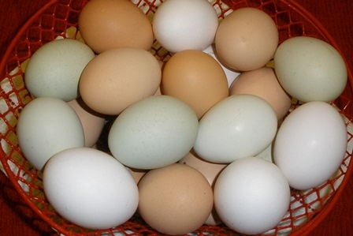
STARTEGY TO RESOLVE THESE PROBLEMS
Establishing line specific marker set
optimal and efficient marker set usage for each elite line
Continuous and sustainable marker research
for changing marker – QTL linkages, interactions, mutations, environment
Genetic diversity control
old challenge in animal breeding: uniform performances AND
maintenance of variation necessary for selection

Slide 33
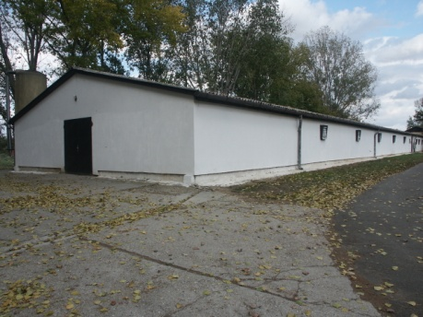
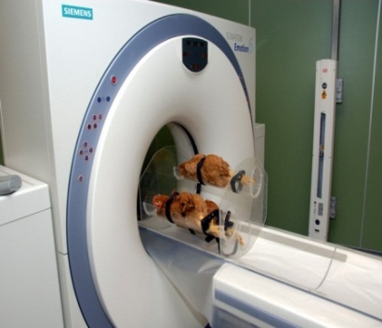
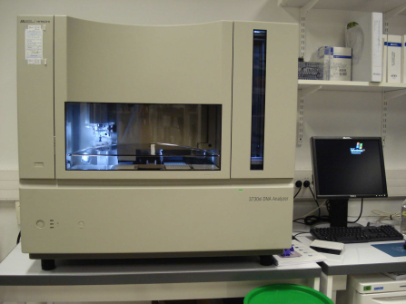
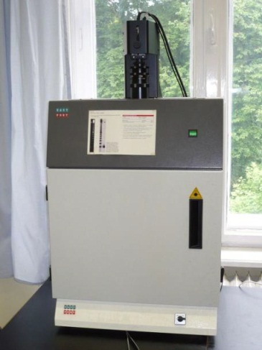
COLLABORATIONS
Centre for Farm Animal Gene Conservation (molecular genetics, biotechnology, cryopreservation) - Gödöllő
Kaposvár University (performance tests, computer tomography, chemical compositions, animal nutrition, behavioral studies) - Kaposvár

Slide 34
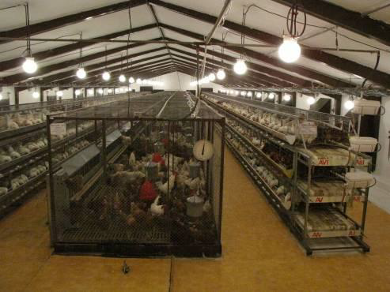
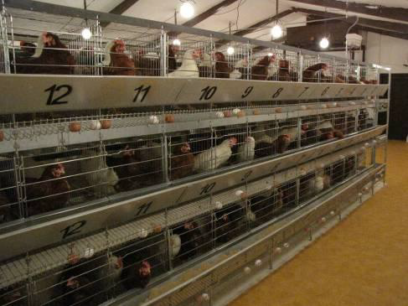

COLLABORATIONS
Group tests (cage, alternative system) in furbished cages (EU conformity)
Correlation between the fat content of egg yolk and body in brown and white layer lines
Effect of cocks on the social behavior of grouped hens
Investigation of nesting behavior of different layer lines
Further development of Long Life Laying program

Slide 35
LATEST INVESTMENTS

Slide 36
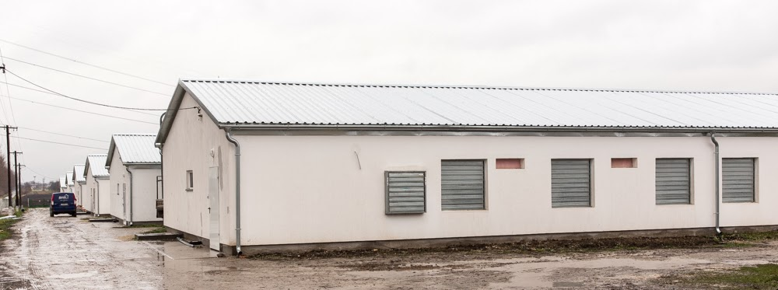
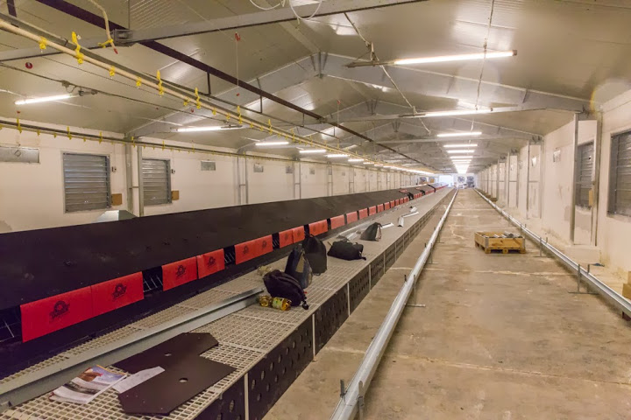
NEW PRODUCTION UNIT FOR PARENT STOCK

Slide 37
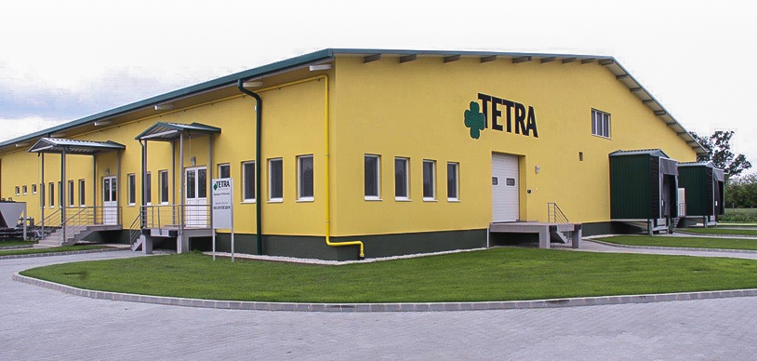
NEW HATCHERY FOR LAYERS – 2014 March

Slide 38
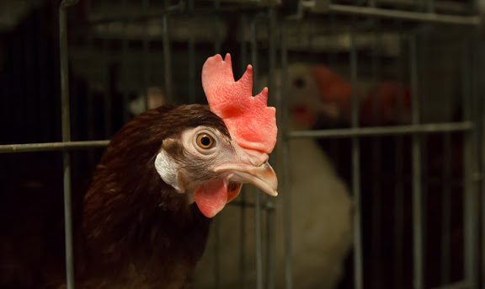
THANK YOU FOR YOUR KIND ATTENTION!

